Slide 1


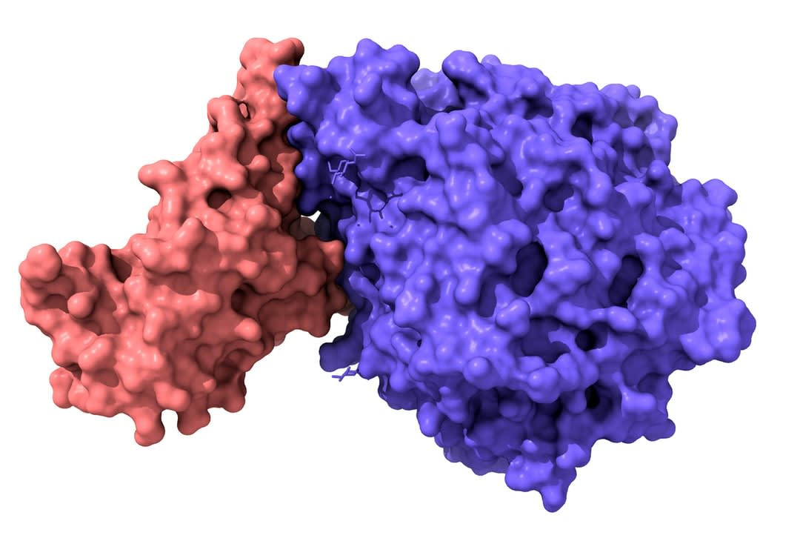

Specific Pupylation as IDEntity Reporter (SPIDER) to decipher Protein-Biomolecule Interactions
江何伟 青年研究员
jianghewei@lglab.ac.cn
临港实验室先进技术部

Slide 2
Protein
Peptide
PD-1 ~ PD-L1
Insulin
DNA
- Biomolecule
Transcription factor
Protein
RNA
m⁶A Reader
Lipid
Small Molecule
RavD
Drugs

Slide 3
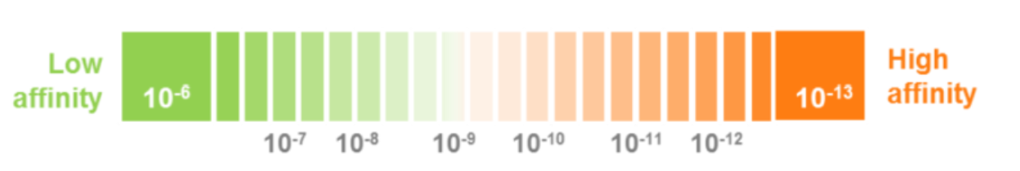

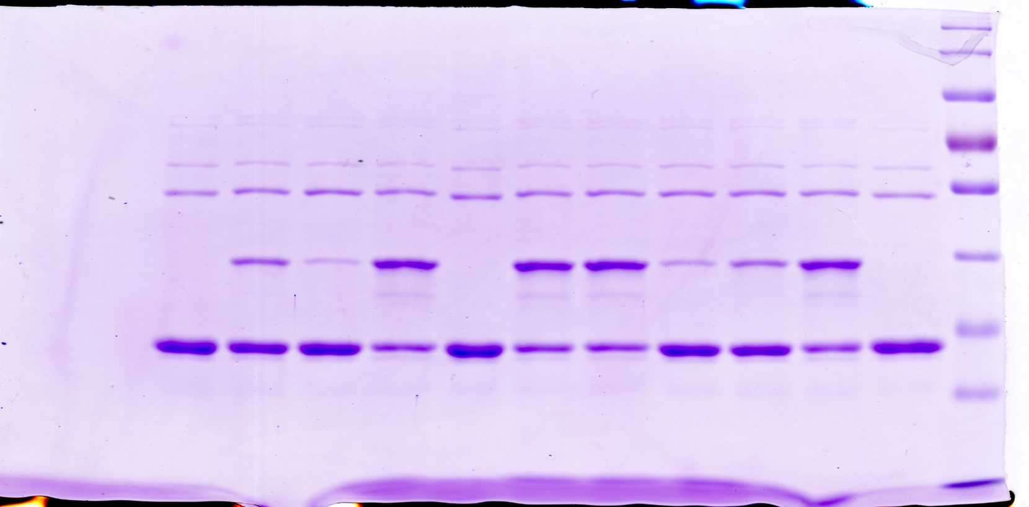
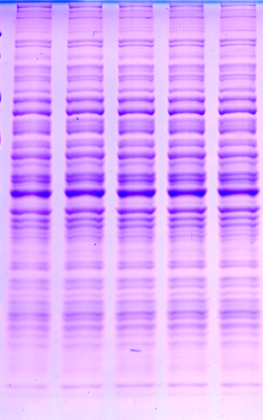
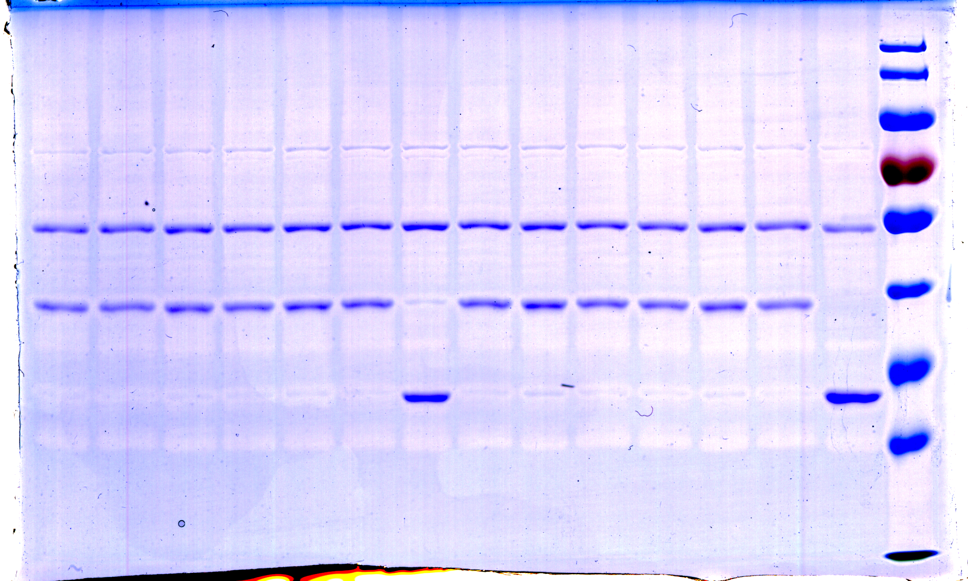
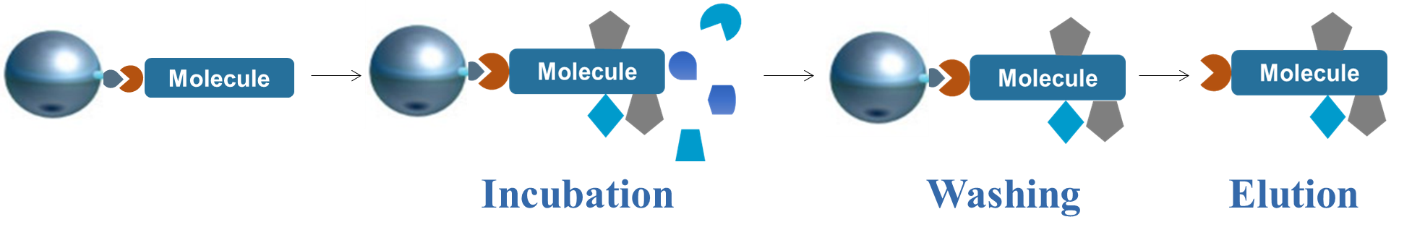
AP-MS
Traditional methods:
Your Ideal
Your Reality
Affinity purification mass spectrometry
Control
Control
Bait
Control
Bait
Bait
Biomolecule
Simple and Rapid

Slide 4
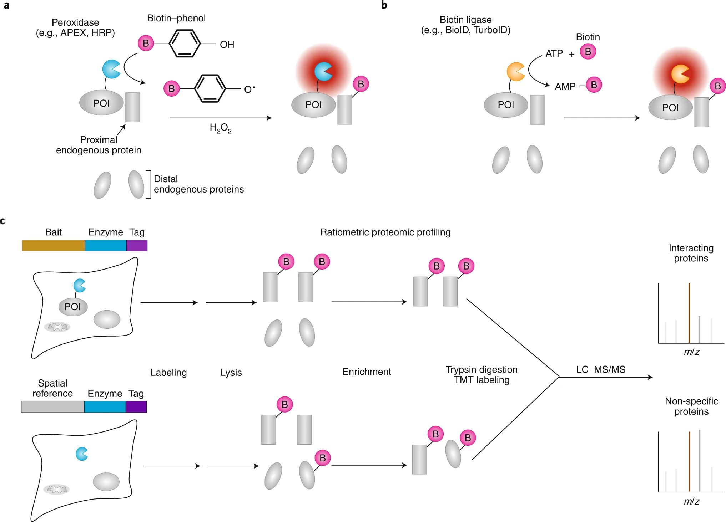
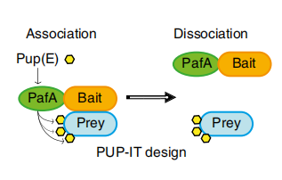


Proximity-tagging systems
BioID
APEX
PUP-IT
√
Biotin-Streptavidin 规避washing问题
√
Trap weak and transient interaction
Not suitable for non-transfectable scenarios
❌
Not suitable for specifically modified biomolecules
❌
Science. 339, 1328 (2013)
Nature Methods. 15, 715–722 (2018)

Slide 5


Proximity-tagging systems
需要转染融合表达，不适用转染效率低的样本或者组织等
不适用于所有分子, 例如特定修饰的生物分子
系统建立
是否可以结合AP-MS 和邻近标记系统的两大优势力量
建立一套适用于分子-蛋白互作的通用方法？
Biomolecule
Wash 相对tricking，考验操作
很难捕捉weak and transient interaction

Slide 6
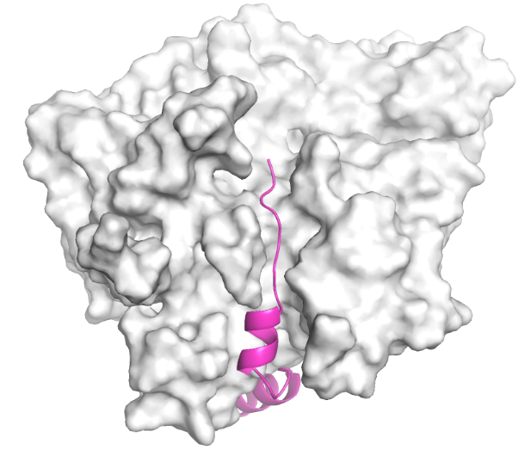
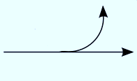


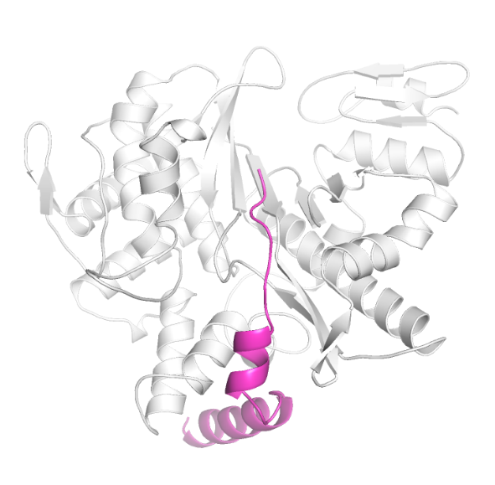

Pupylation
Ubiquitination
O
O
Ub
PafA~Pup Complex
Pup
-Gly-Gly-Gln-C
-Gly-Gly- -C
NH₂
O⁻
H₂O
Preparation of tag
USPs
UCHs
O
Dop
ATP
NH₄⁺
-C
O
O⁻
O
Ub
Pup
-Gly-Gly-Glu-C
-Gly-Gly-C
O⁻
O⁻
ATP
ATP
PafA
E1
ADP
Activation
PPi
O
O
Ub
Pup
-Gly-Gly-Glu-C
-Gly-Gly-C
O-
O~AMP
P
Substrate
E1
Substrate
PafA
E2
Pi
E3
AMP
O
Ligation to substrate
O
Pup
-Gly-Gly-Glu-C
Ub
-Gly-Gly-C
NH
I
Lys
I
NH
I
Lys
I
Substrate
Substrate

Slide 7
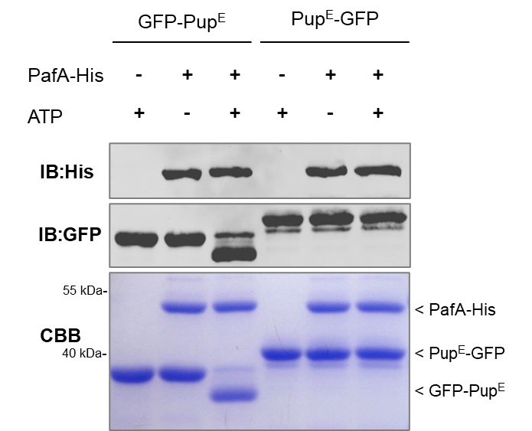
Serendipitous Finding
MALDI-TOF-MS
1.0
35894.43 Da
2 Experimental
2
0.5
Relative intensity
30000
35000
40000
1
2
0.0
1000
1500
2000
2500
3000
Pup^{E}
1.0
35913.26 Da
1 Control
GFP
PafA
1
Relative intensity
0.5
Pup^{E}
30000
35000
40000
K
PafA
GFP
0.0
1000
1500
2000
2500
3000

Slide 8

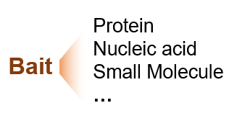
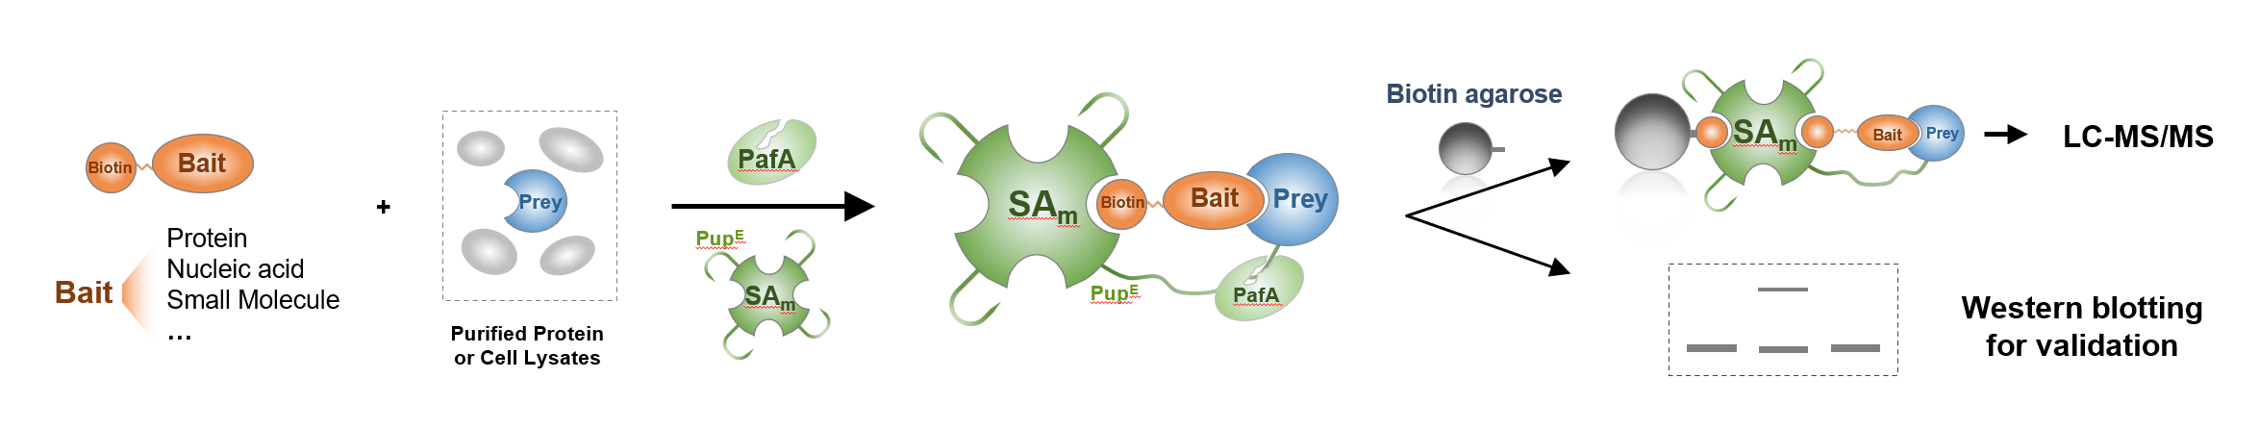
SPIDER
Pup^{E}
SA_{m}
Bait
Prey
Biotin
SPIDER for protein-protein interactions (PPI)
SPIDER for protein and nucleic acid interactions (PNI)
SPIDER for protein and small molecule interactions (PSMI)
PafA
SA_{m}
Bait
Prey
Biotin
PafA

Slide 9
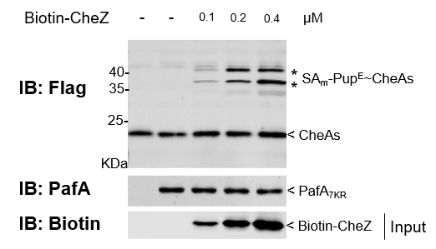
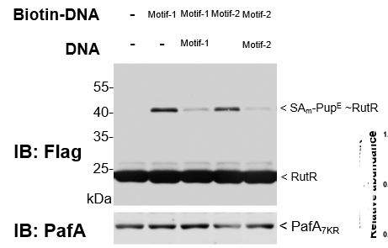
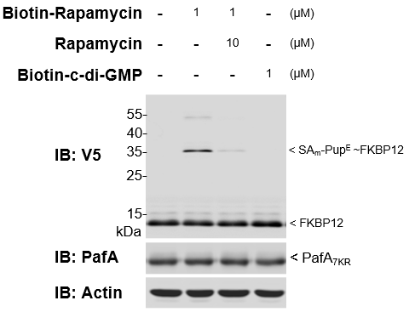
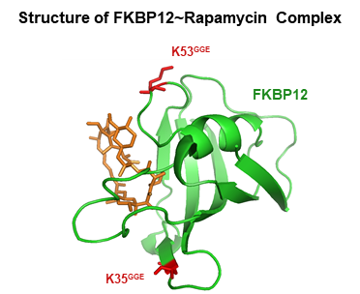
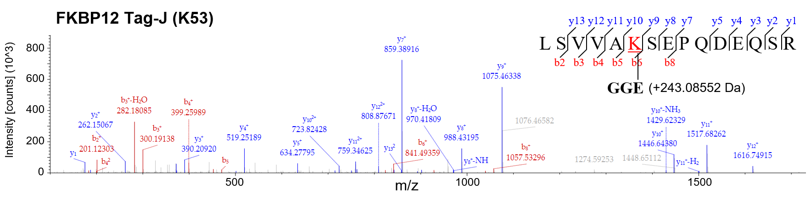
SPIDER for Validation
CheAs~CheZ interaction
RutR~DNA interaction
FKBP12~Rapamycin interaction
PPI
PNI
PSMI

Slide 10
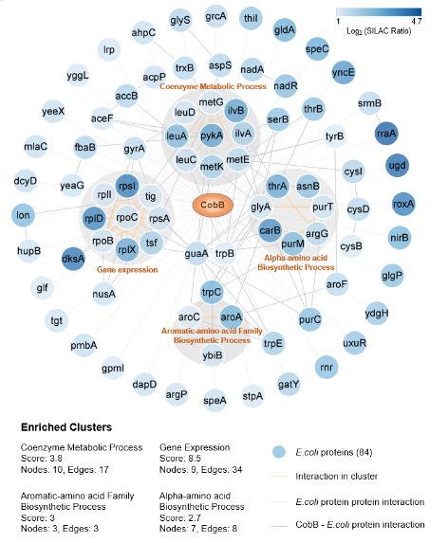
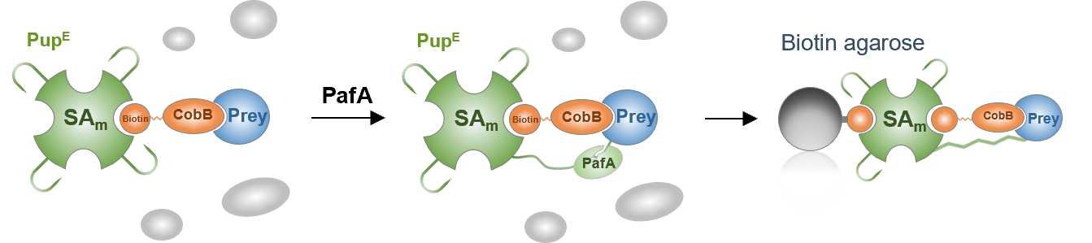
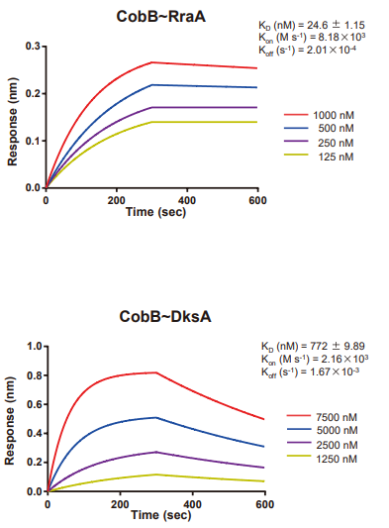
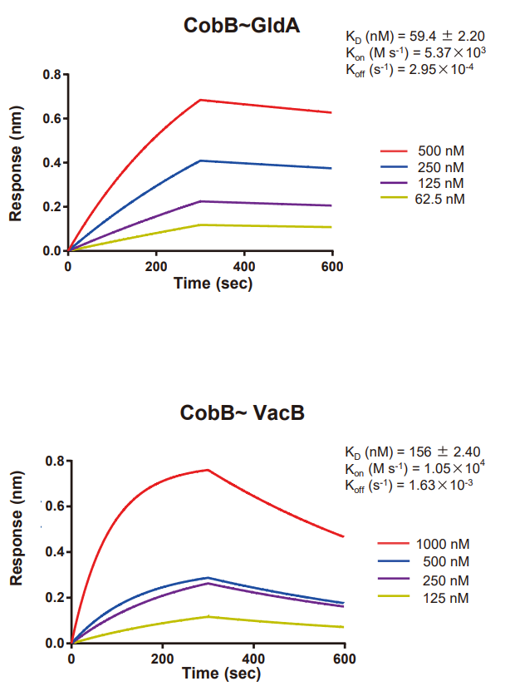
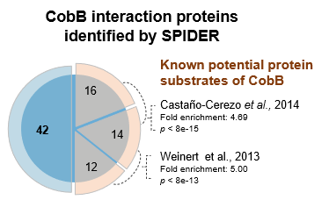
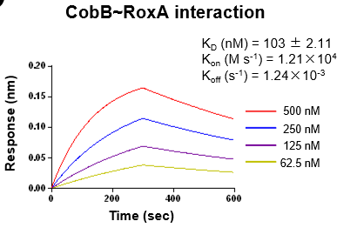
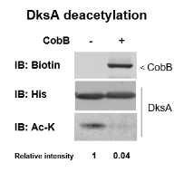
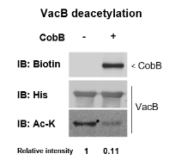
SPIDER-PPI to identify enzyme-substrate interactions
Deacetylase CobB

Slide 11
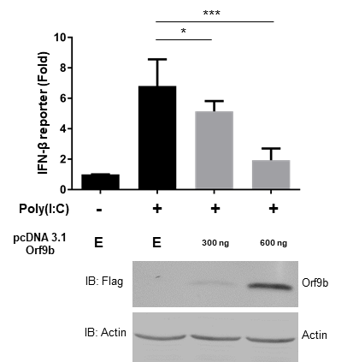
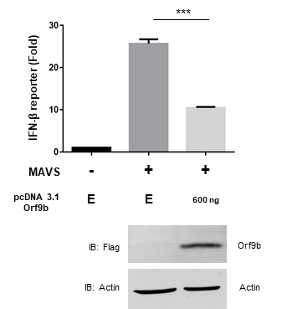
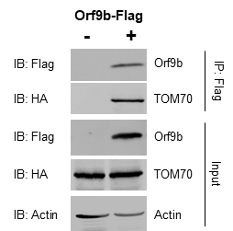
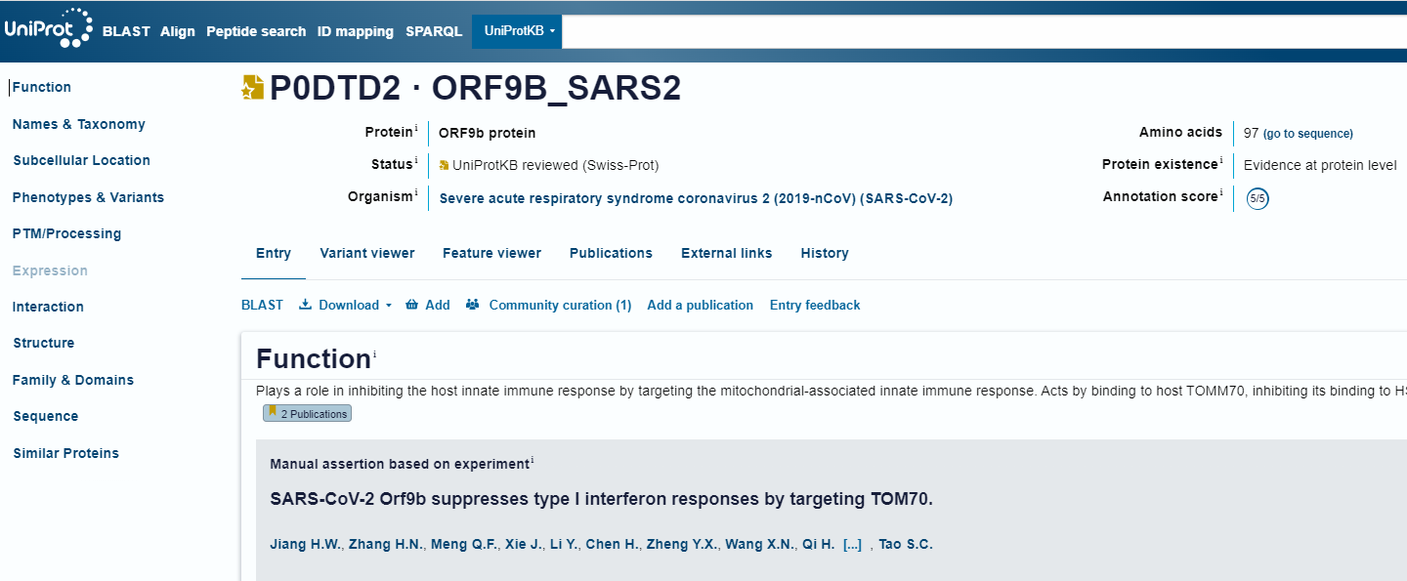
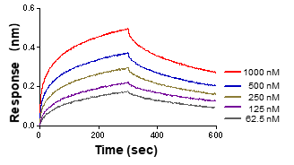
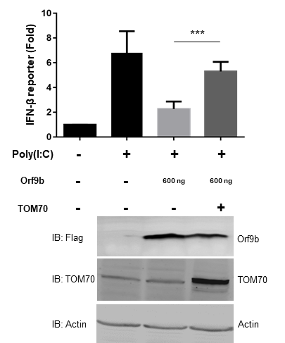
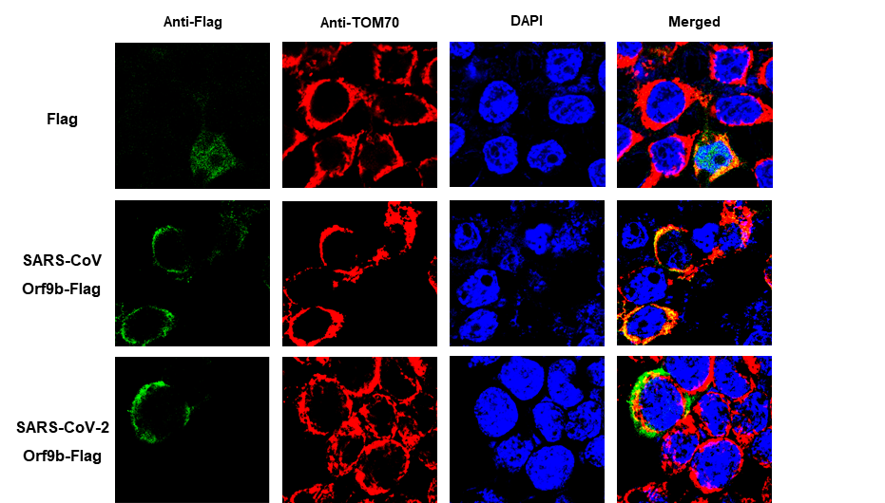
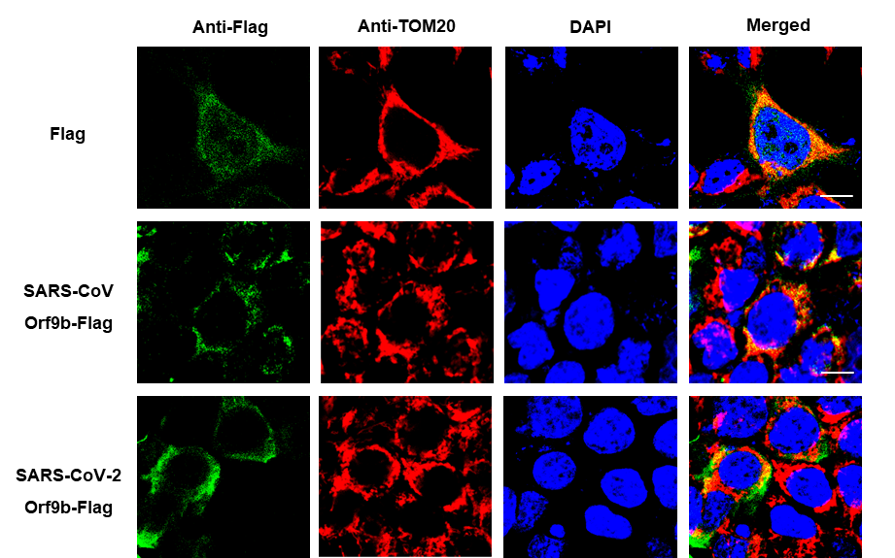
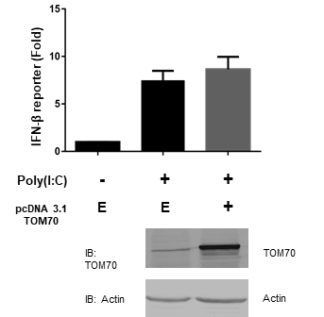
SARS-CoV-2 Orf9b inhibit IFN-I Responses through TOM70
Orf9b ~ TOM70
K_{d} (nM) = 44.9 ± 0.795
K_{on} (M s⁻¹) = 4.43×10⁴
K_{off} (s⁻¹) = 1.99×10⁻³
Orf9b – TOM70
Orf9b – Mitochondria
Cellular & molecular immunology, 17(9), 998–1000.

Slide 12
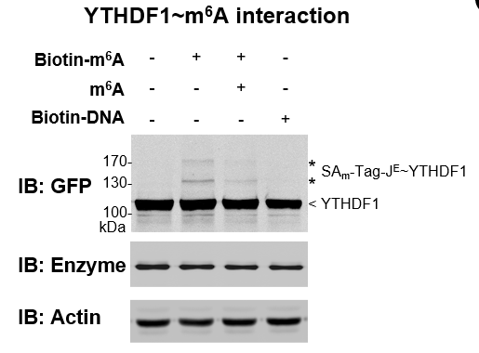
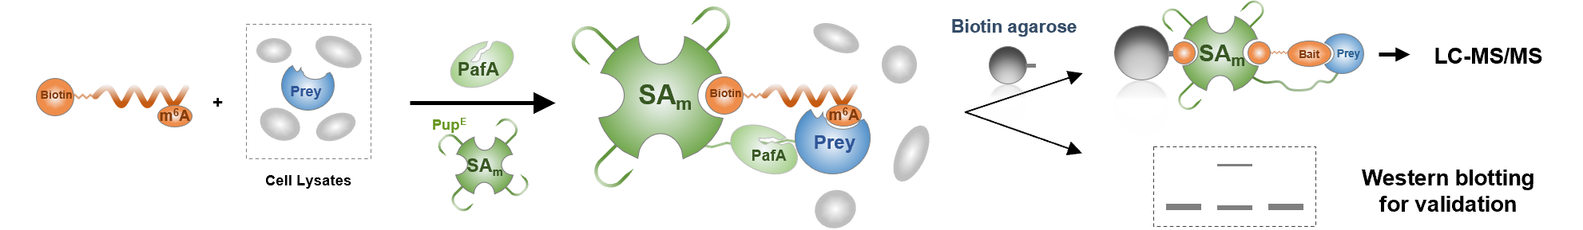
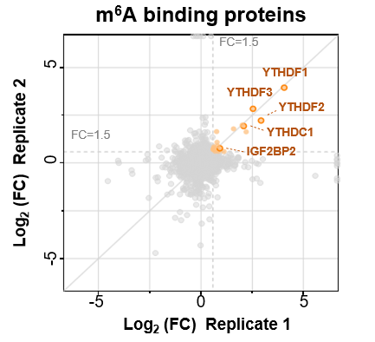
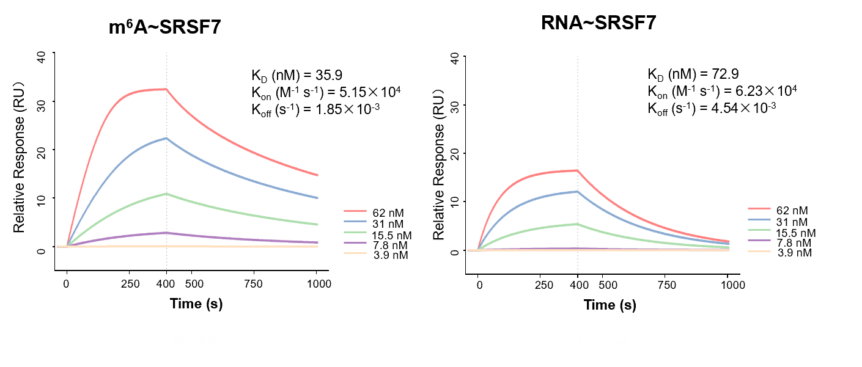
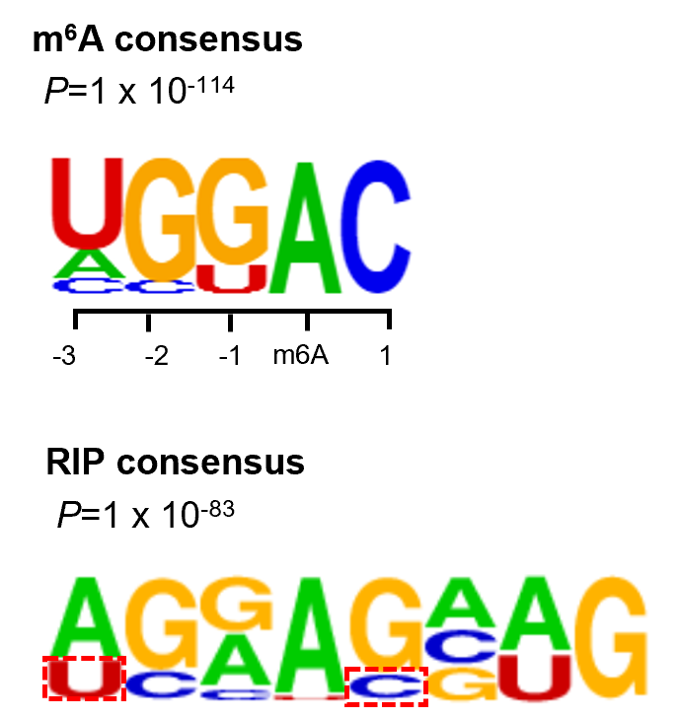
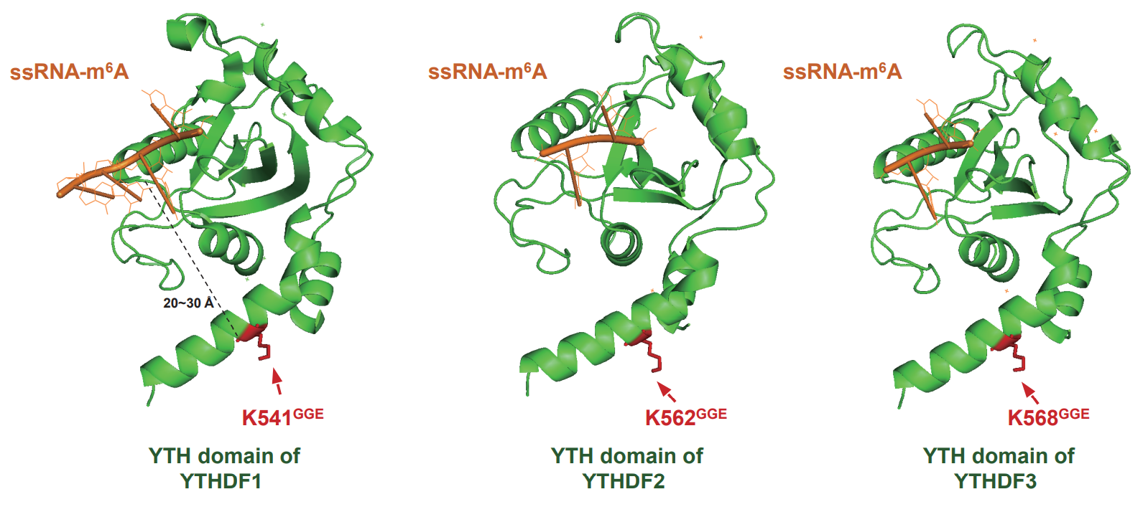
SPIDER-PNI to identify m⁶A readers
Identify m⁶A readers

Slide 13
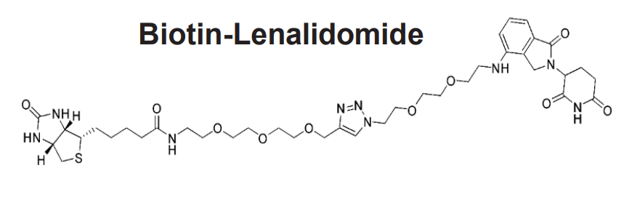
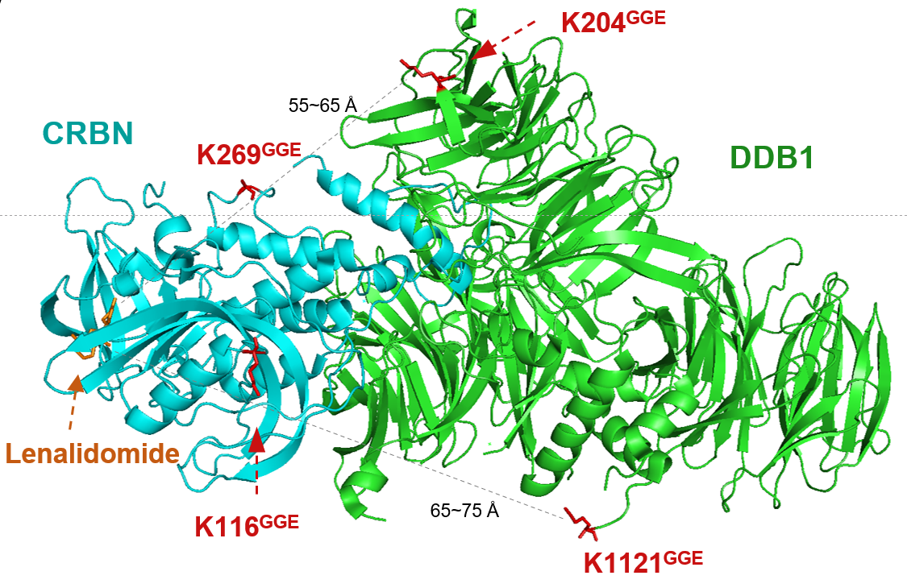
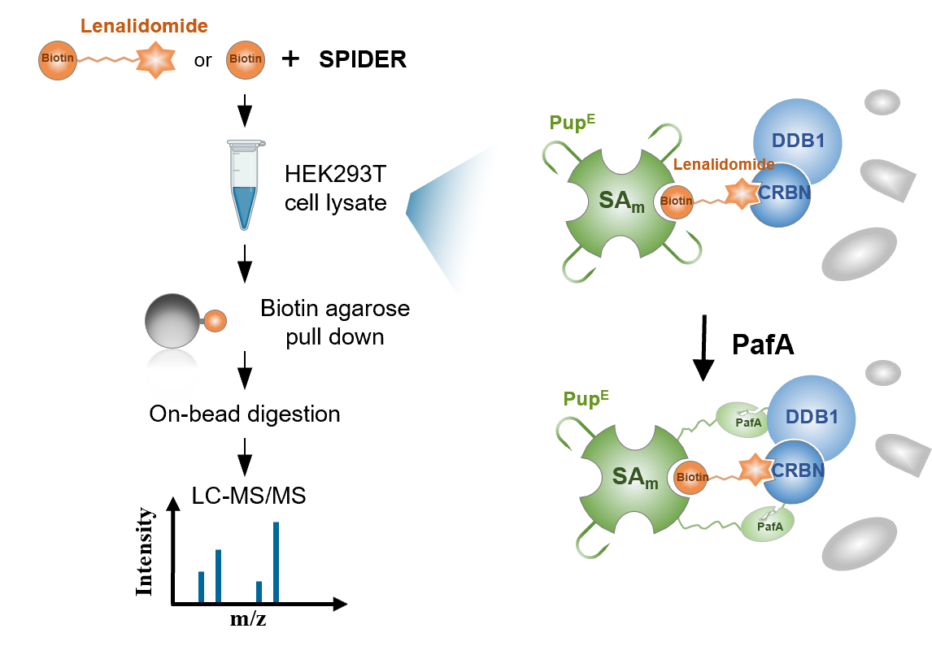
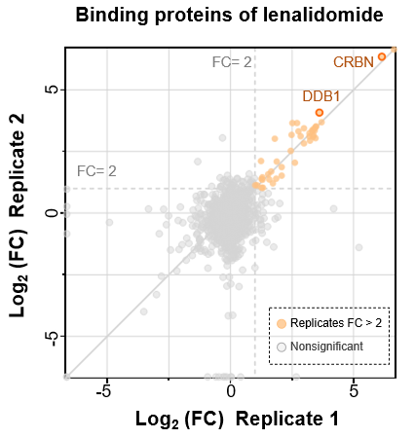
SPIDER-PSMI to capture the targets of lenalidomide
青蒿素
小檗碱
阿兹夫定
……
Science China Life Science. 2023;1-19.

Slide 14
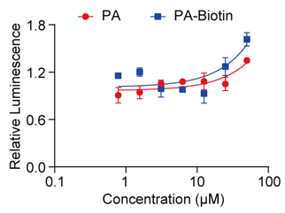
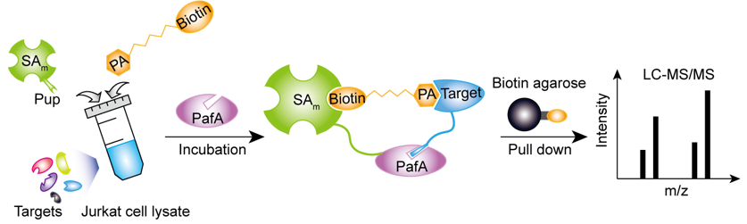
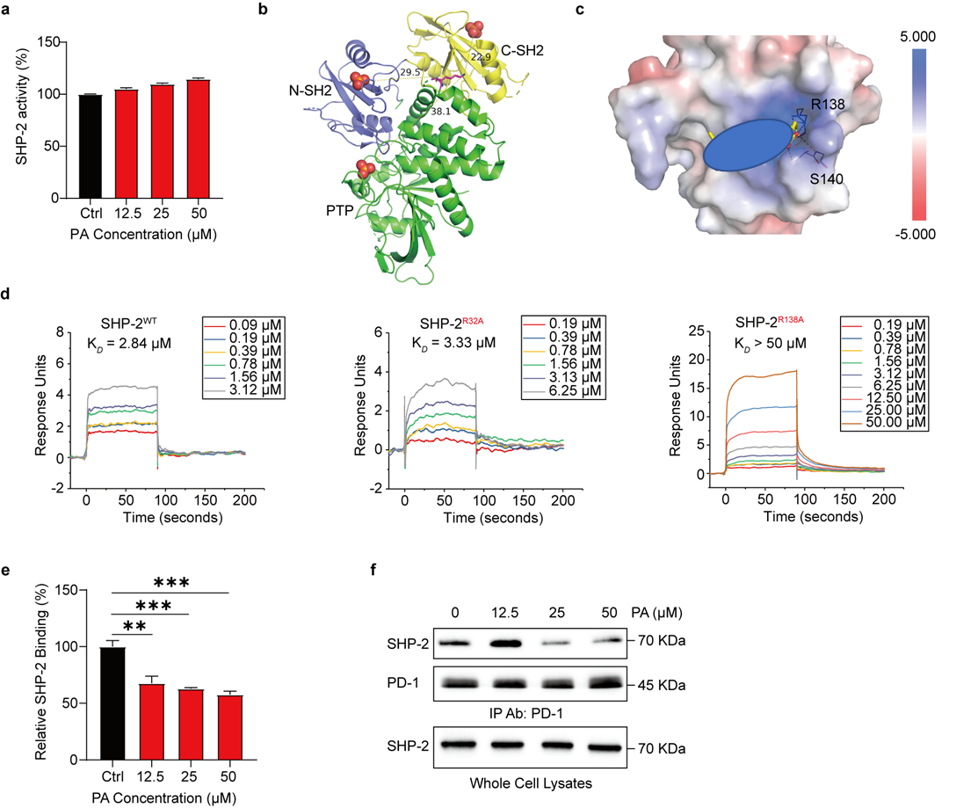
SPIDER for the lead compound PA
K68
Unpublished Data

Slide 15

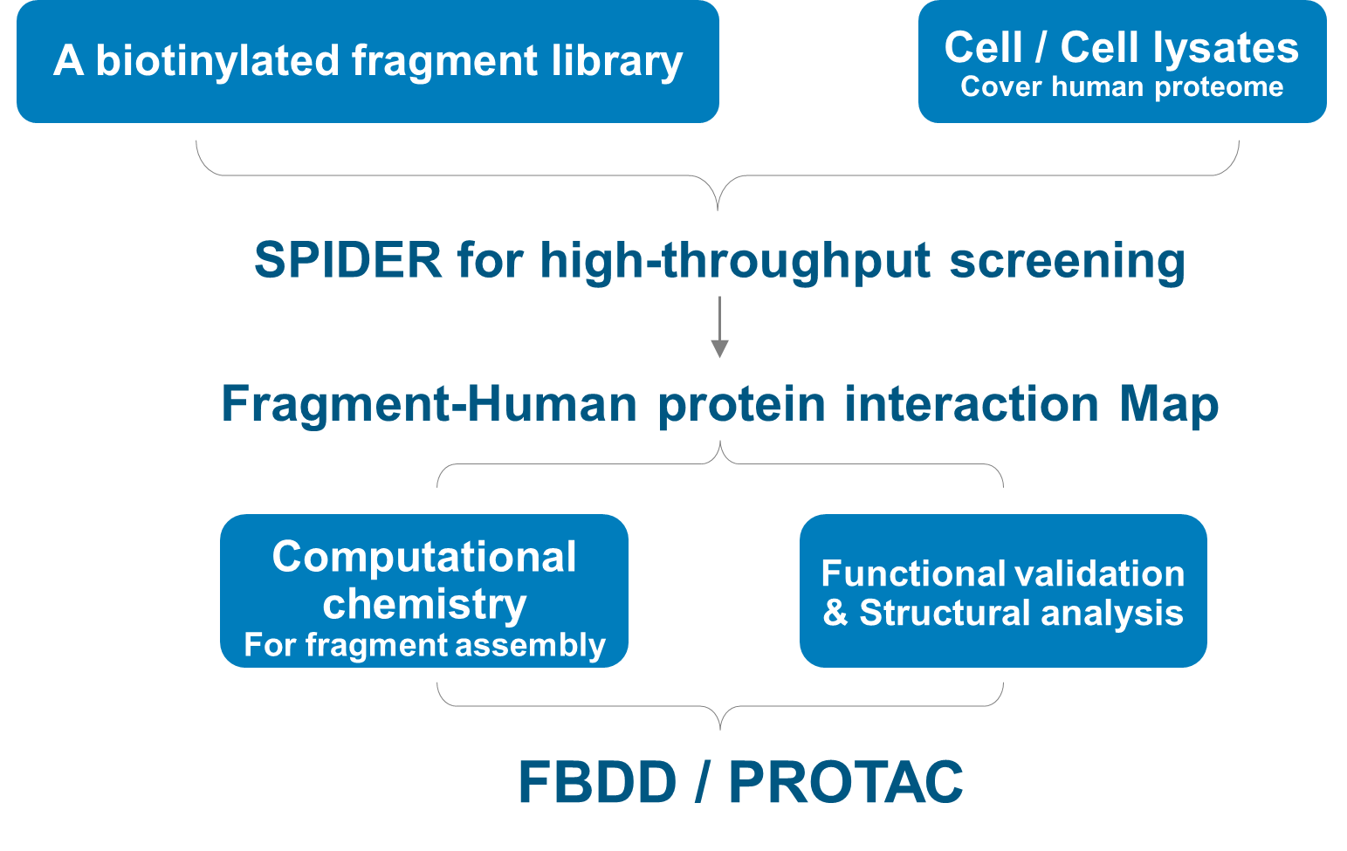







Network for Fragment library-Human proteome
linker
Small-molecule
fragment
Biotin
Biotin
Biotin
＋
~ 5000
“Hot”
Biotinylated probes
“Cold”
Fragment competitors
“Heavy” cell lysate
“Light” cell lysate
1) Incubate
2) SPIDER reaction
Competed target
4-烷基糖苷
COMBINE
3) Enrich
4) Digest
5) LC-MS/MS
1+1>2
MS1 Intensity
MS1 Intensity
Fatima Mustafa et al. Analytica Chimica Acta (2021)
Non-competed target
Competed target

Slide 16


Ligand-Receptor interactions in Cell Surface
Ligand-Receptor
Membrane protein extraction
Pull down
1. Plasma membrane proteins that are often hydrophobic. 提取膜蛋白的buffer常带有强的表面活性剂，容易破坏互作
2. cell surface proteins typically need to be embedded in their natural environment to exhibit their characteristic binding properties.在细胞或者组织原位去研究互作

Slide 17


SPIDER to identify ligand-receptor interactions
抗体药物的靶标 off-target
Science China Life Science. 2023;1-19.

Slide 18




Deciphering Virus Receptors
2 Known Receptors
Control
MYH10
Protein X
Advantages：
1. In situ idetification
2. No need prerequisite knowledge of ligand
Unpublished Data

Slide 19
Review
Method |  |  |  |  | Advantages | Disadvantages
 | PPI | PNI | PSMI | Other biomolecules
TAP-MS | + | - | - | - | High specificity | In vitro only; Not suitable for weak and membrane-based PPI
BioID | + | + | - | - | Suitable for weak and membrane-based interactions | Specificity need to be improved; Fused BirA may sterically interfere with interactions
APEX | + | + | - | - | Suitable for weak and membrane-based interactions | Specificity need to be improved; Fused APEX may sterically interfere with interactions; Limited application in vivo because of the toxicity of H₂O₂
PUP-IT | + | + | - | - | Suitable for weak and membrane-based interactions | Specificity need to be improved; Fused PafA may sterically interfere with interactions
RAP-MS | - | + | - | - | High specificity with UV cross-linking and long oligonucleotide probes (120 nt) | High input cell numbers； Highly dependent on UV cross-linking efficiency
Covalent affinity probes | + | - | + | - | High specificity; Suitable for weak and membrane-based interactions | Case-by-case rational design; Complicate de novo synthesis; Need additional cross-linking by UV or chemical reagents
SPIDER | + | + | + | + | High generality- All purpose; Simple; High specificity; Suitable for weak and membrane-based interactions; | The current form is In vitro only

Slide 20


Review
SPIDER
8M Urea
AP-MS
PBS

Slide 21







Review
Membrane PPI
薛俊彪
Living Cell
ln Vitro
Enzyme-baesd
Proximity-tagging System
non-transfectable scenarios
specifically modified biomolecules
Specific Modified
Biomolecules Binder
PPI PNI
HRP-PPI
Tissue

Slide 22






邻近标记分子靶标鉴定技术开发及应用
总体目标:
以分子靶标鉴定技术开发为主，解决分子互作如小分子靶标和病原宿主互作领域的难点问题
病原体宿主靶标时空分辨鉴定及技术开发研究
病原体如MTB / SARS-CoV-2 / HSV-1
EBioMedicine. 2018;30:225-236.
EBioMedicine 2022;75:103773.
Cellular & molecular immunology. 2023;1-3.
已经获批的药物
副作用、老药新用和中药靶点确定
分子靶标鉴定
适用：
小分子药物
大分子如抗体
膜蛋白互作
核酸蛋白互作
邻近标记技术SPIDER
及蛋白质组芯片
小分子砌块靶标
高通量鉴定
Fragment-Based
Drug Design
Nature Communications. 2020;11(1):3581.
Cellular & molecular immunology. 2020;17(9):998-1000.
Science China Life Science. 2023;1-19.
Cell Discovery 2022;2-11.

Slide 23



Acknowledgements
陶生策 教授 （上海交大）
王方军 研究员 （大连化物所）
董佳家 教授 （上海交大）
蔡宇伽 研究员 （上海交大）
裴剑峰 研究员 （北京大学）
汪涛 研究员 （深圳湾实验室）
SPIDER研究组
十三五重大专项，
十四五重点研发计划

Slide 24

欢迎加入临港实验室
分子靶标鉴定技术开发团队!
江何伟
jianghewei@lglab.ac.cn

